Slide 1
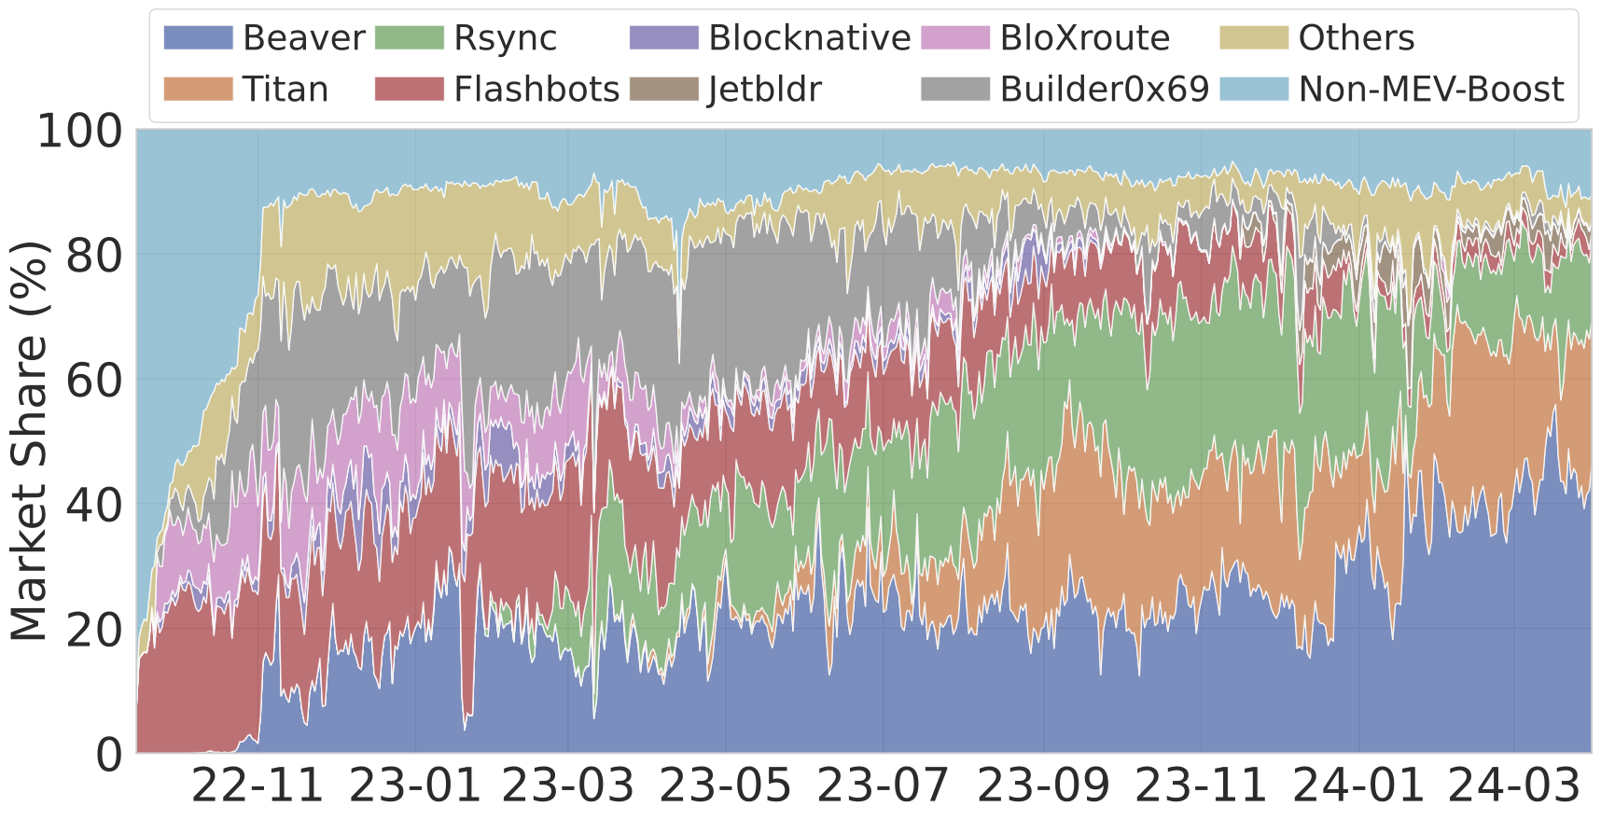
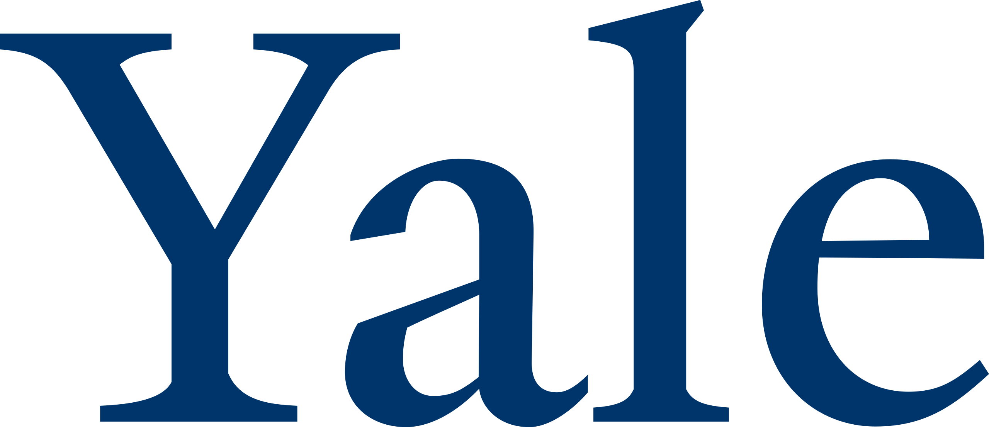

(De)centralization of Ethereum’s builder market
Fan Zhang
Asst. Prof. Yale CS
Science of Blockchain Conference
August 8, 2024
Joint work with Sen Yang (Yale) and Kartik Nayak (Duke)

Slide 2
Decentralization, Decentralization, Decentralization!
Transparency
Immutability
Security
Technical neutrality
Future of FinTech
Censorship Resistance
Verifiability
How are we doing on decentralization in practice?
Notes:
If we have to summarize using one word, what makes blockchains a blockchain, that word would be decentralization, which roughly means that a system is not controlled by a handful of parties.
The natural question then is how are we doing on decentralization in practice?
Are practical systems, like Ethereum, sufficiently decentralized in all aspects?
In this talk, we will talk about arguably one of the least decentralized component of Ethereum

Slide 3
MEV is a threat to decentralization
ME V: profit from manipulating txns ordering
~$1 m per day [varies, see https://explore.flashbots.net]
MEV is a centralizing force
big validators (e.g., backed by trading firms) will outcompete small validators (e.g., hobbyist)
Ethereum’s solution: Proposer-builder separation (PBS)

Slide 4


PBS and builder market
Idea: outsource block building (i.e., MEV extraction) to builder market.
I’ll pay 90 for my block
I’ll pay 95 for my block
implementation: MEV-Boost
validator / proposer
I’ll pay 98 for my block
I’ll pay 99 for my block
In operation since the Merge (2022)
Ideally, validators get most of the MEV in auction revenue
New player: Builders
Notes:
With PBS, when a validator is due to propose a block, at which point it becomes a proposer, it goes the builder market
And sells the block space

Slide 5
Market share of Ethereum’s builders market
Three builders build ~90% blocks as of March 2024
Notes:
how is PBS fighting centralization
it's rather unclear. because the builder market itself is hyper centralized

Slide 6
Is centralized block building okay?
Builder market centralization is thought to be “okay”
“centralized block production is fine as long as [validators are decentralized]” --- ethereum.org
We are not convinced by this argument
Concern: proposers would incur a profit loss in a centralized builder market.
Proposer loss has undesired consequences.
The market share of block builders over time.
Notes:
This certainly does not look very decentralized
this phenomenon is well known in the community
so the purpose of this talk is not to break the news that we have a centralized builder market, but to understand the underlying causes and the implications
first, what caused the market to centralize? this will help to develop countermeasures
second, what are the implications? implication is not binary. decentralization is not the goal, but a means to a goal. What damages will the lack of decentralization cause, and how much should we worry?
I’ll introduce some background before I can elaborate on the questions

Slide 7
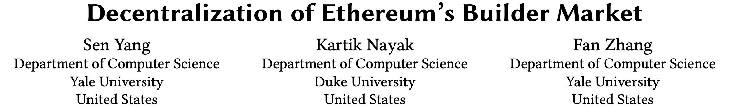
Implications of proposer loss
#1: Instability of PBS
Proposers might be incentivized to extract MEV themselves.
Big validators have competitive advantages or small ones, leading to validator centralization.
#2: inaccurate MEV oracles
Auctions are used to measure MEV (MEV oracles) (e.g., MEV burn).
proposer loss ⟹ inaccurate MEV oracles
This talk: quantify the loss, understand its causes, and explore mitigation.

Slide 8
Modeling MEV Auctions
In each instance, builders submit bids in the form of (B, BV)
B: a block
BV: amount to pay if bid is accepted
Builder’s true valuation (TV) underlying a bid B := balance increase after executing B
i.e., TV(B) is the sum of values from txns in B
When auction concludes, B with the highest BV wins.
Block B is added to the blockchain
Builder of B gets TV
Builder pays the proposer BV
Builder’s profit = TV – BV

Slide 9
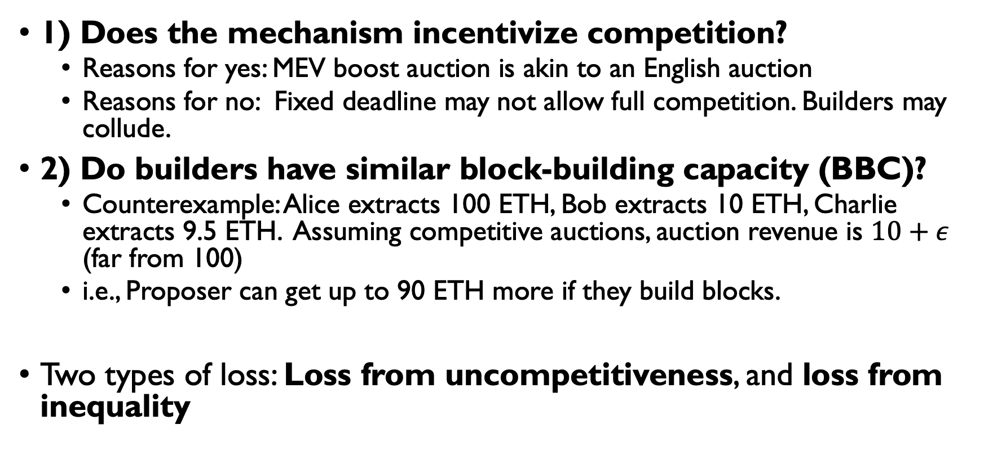
Potential reasons for proposer loss
1) Does the mechanism incentivize competition?
Reasons for yes: MEV boost auction is akin to an English auction
Reasons for no: Fixed deadline may not allow full competition. Builders may collude.
2) Do builders have similar block-building capacity (BBC)?
Counterexample: Alice extracts 100 ETH, Bob extracts 10 ETH, Charlie extracts 9.5 ETH. Assuming competitive auctions, auction revenue is $10+ε$ (far from 100)
i.e., Proposer can get up to 90 ETH more if they build blocks.
Two types of loss: Loss from uncompetitiveness, and loss from inequality

Slide 10
Proposer loss definition
Loss from inequality
TV = True Value
TV_{N}
TV_{N-1}
TV₂
TV₁
…
Value (in ETH)
Winning bid
Loss from uncompetitiveness

Slide 11
Quantification of proposer losses
Practical challenge: auction data is not recorded on-chain
Blockchain only records the winning bids. We need losing bids too.
We started to archive auction bids since 2022
5 billion partial bids (block hash, bid) since Sep 2022 to March 2024 (collected by querying relays)
full bids (partial bids + txns) from ultra sound relay (200 GB / day)
cross validation against public datasets & related papers
Notes:
to answered these questions, we took an empirical approach.
the first challenge is the lack of data. Specifically, although the blockchain records the winning bids, the bids that didn’t win are discarded and cannot be retrieved retroactively
so to enable this study, we started to archive auction data since 2022
we also obtained full bids from ultra sound for a short period of time, because there is simply too much data in full bids (200 GB per day)

Slide 12
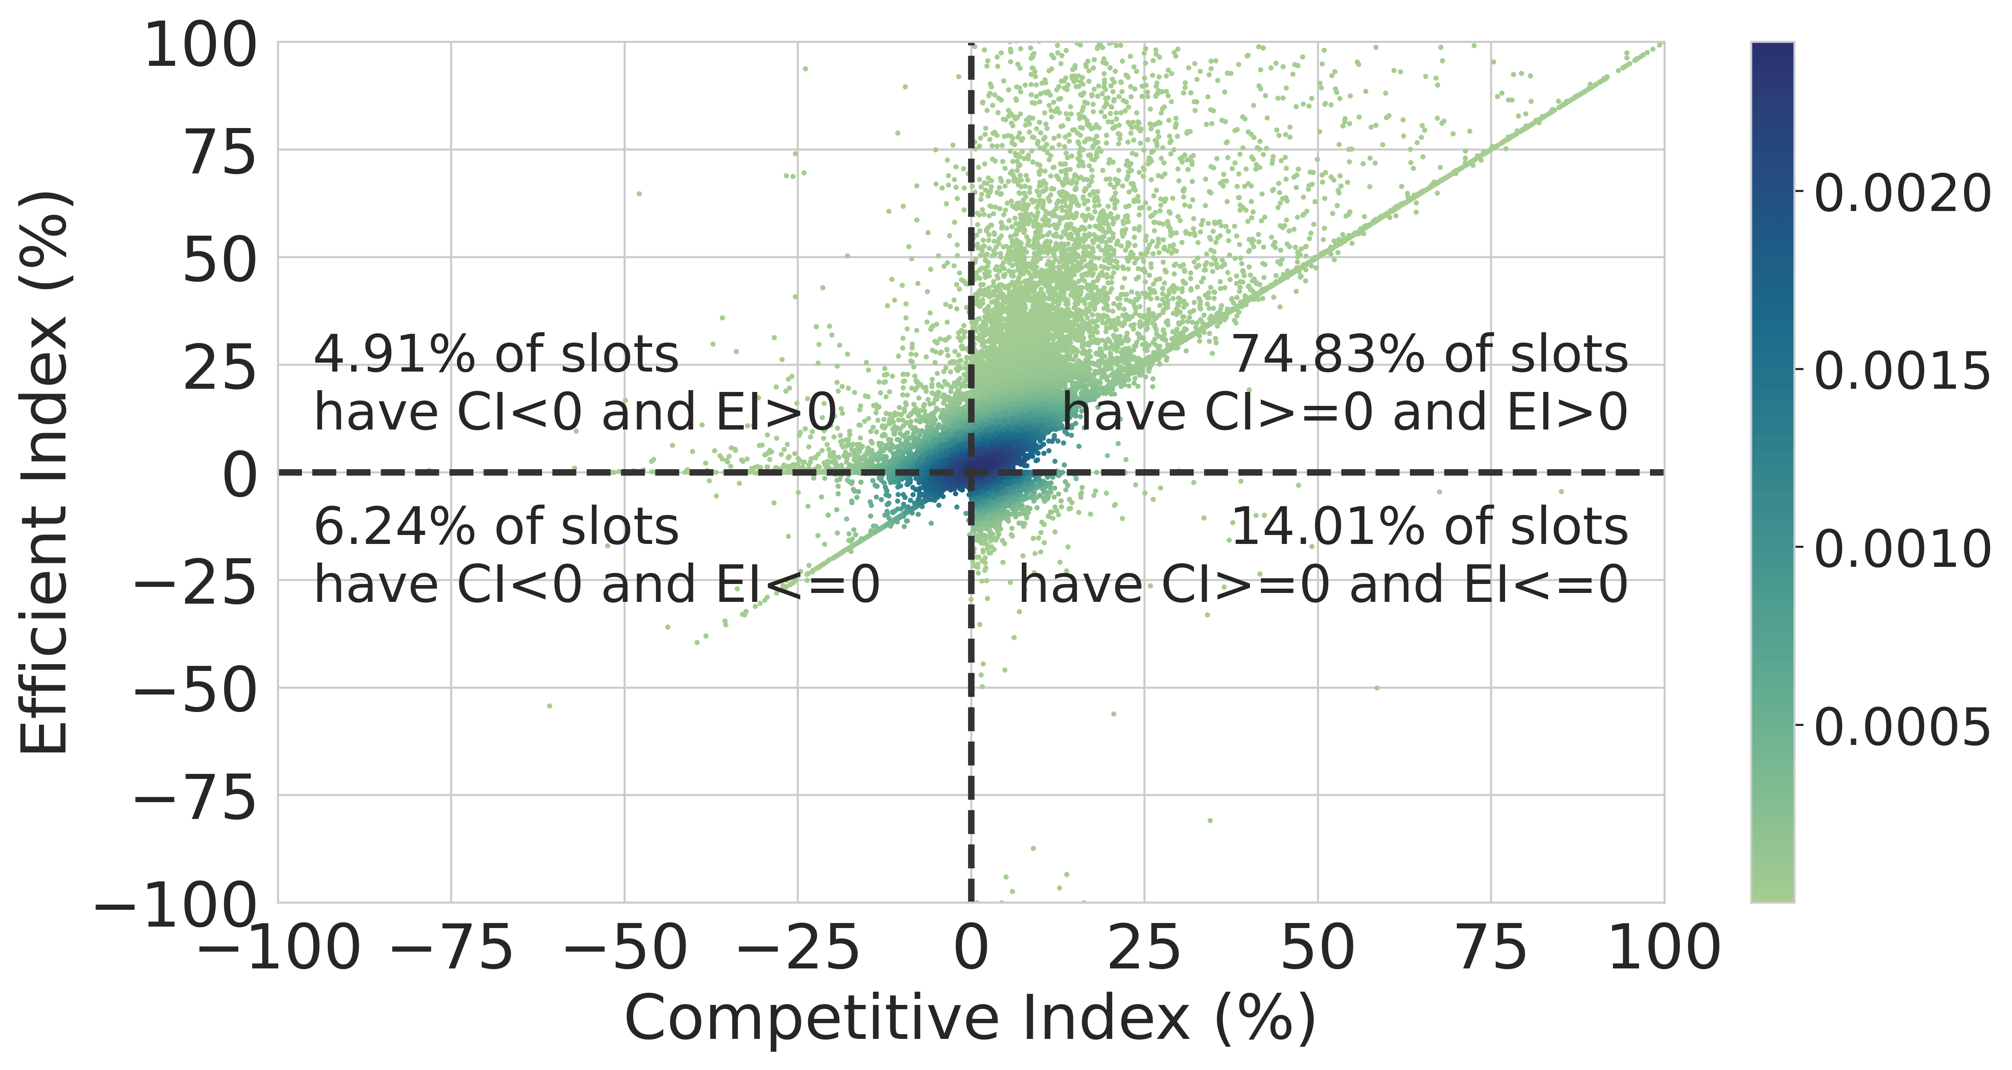
Result: competitiveness of past MEV auctions
Competitive := winning bid > second highest true value
Efficient := winner has the highest TV
Examined auctions from April 9-15, May 1-7, June 1-7, July 1-7, and August 1-7, 2023
Competitive: 89%
Efficient: 80%
Both: 75%
efficient
competitive

Slide 13
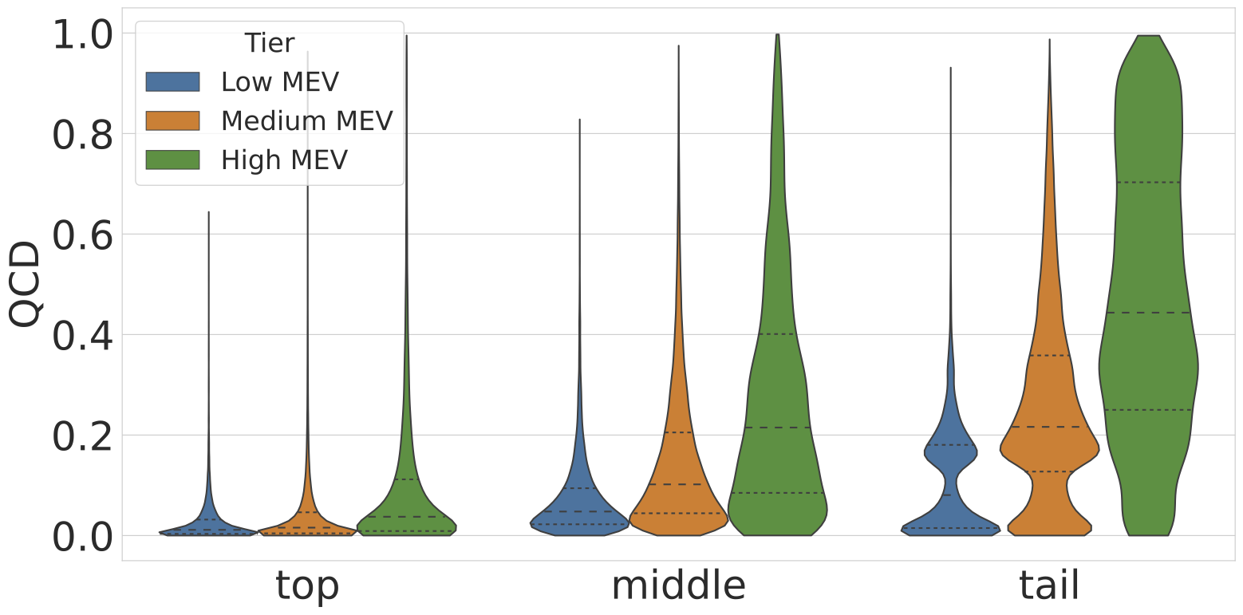
Result: Inequality of block-building capacity
Builder’s true valuable represents its block-building capability
We use Quartile coefficient of dispersion (QCD) to measure the disparity of true values (the higher the worse)
Top builders have similar capability in low MEV slots.
Inequality worsens as the MEV of a slot increases.
Inequality worsens as we go down the list of builder groups.
Notes:
These are cases.
We systematically measured the differences in builder’s block building capacity

Slide 14
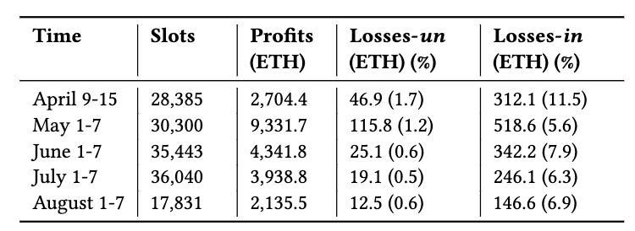
Result: proposer loss in past auctions
Between April – August 2013:
Loss from uncompetitiveness is moderate (~1%)
Loss from inequality (of BBC) is significant (6-12%)
Notes:
We compute TV(B) from transactions in B (using full bid dataset)
A lower bound on the actual gain of builders (the proposer’s loss)

Slide 15
What caused inequality?
Public mempool (p2p network)
Regular users
Wallets
Trading bots
Searchers*
TXs
Third-party private channels
(MEV-Share, MEV Blocker, etc)
Builders
*) Searchers read from mempool and private channels
Public Order Flow
Direct channels
Private Order Flow
A stream of TXs is called an order flow (OF)
Public OF (i.e., mempool) is accessible by all builders.
Private OFs have different accessibility
E.g., telegram bots, searchers, …
15
Notes:
before diving into results, let’s first take a closer look at how exactly builders work.
In today’s Ethereum, transactions reach builders via three means
Here is our model of builders. This model captures the strategic actions taken by builders
We assume builders’ combination algo is similar (thanks to open source impl.)

Slide 16
What caused inequality?
Answer: Access barriers to profitable OFs
Which also explains builder centralization: profitable OFs can only be accessed by a small set of builders
Two reasons
There is a trust barrier between OF providers and builders
Strong incentive to form integration

Slide 17
Inequality due to trust barriers
Malicious builders can harm OF providers, e.g., by unbundling, sandwiching or imitation
Two kinds of access barriers
“reputation”: e.g., MEV-blocker requires 1% market share. New builders face a chicken-and-egg problem (typical reason for subsidy)
“obscurity for security”: most searchers are anonymous
Takeaway: need a fair exchange mechanism
(Centralized) platforms like MEV-Share aim to address this problem

Slide 18
Inequality due to integration
Integration: exclusive OF-sharing between a provider & a builder. Usually done through private deals.
We defined a new metric called pivotal level to identify integration.
We found that all three top builders [~90% market share collectively] have integrated OF providers.
Reveals a previous unknown integration between Banana Gun (a telegram bot) and Titan, jaredfromsubway (a sandwich searcher) and Beaver.
Integration is a *unique* competitive edge for builder.
There is strong incentive to form integration
It avoids competition

Slide 19
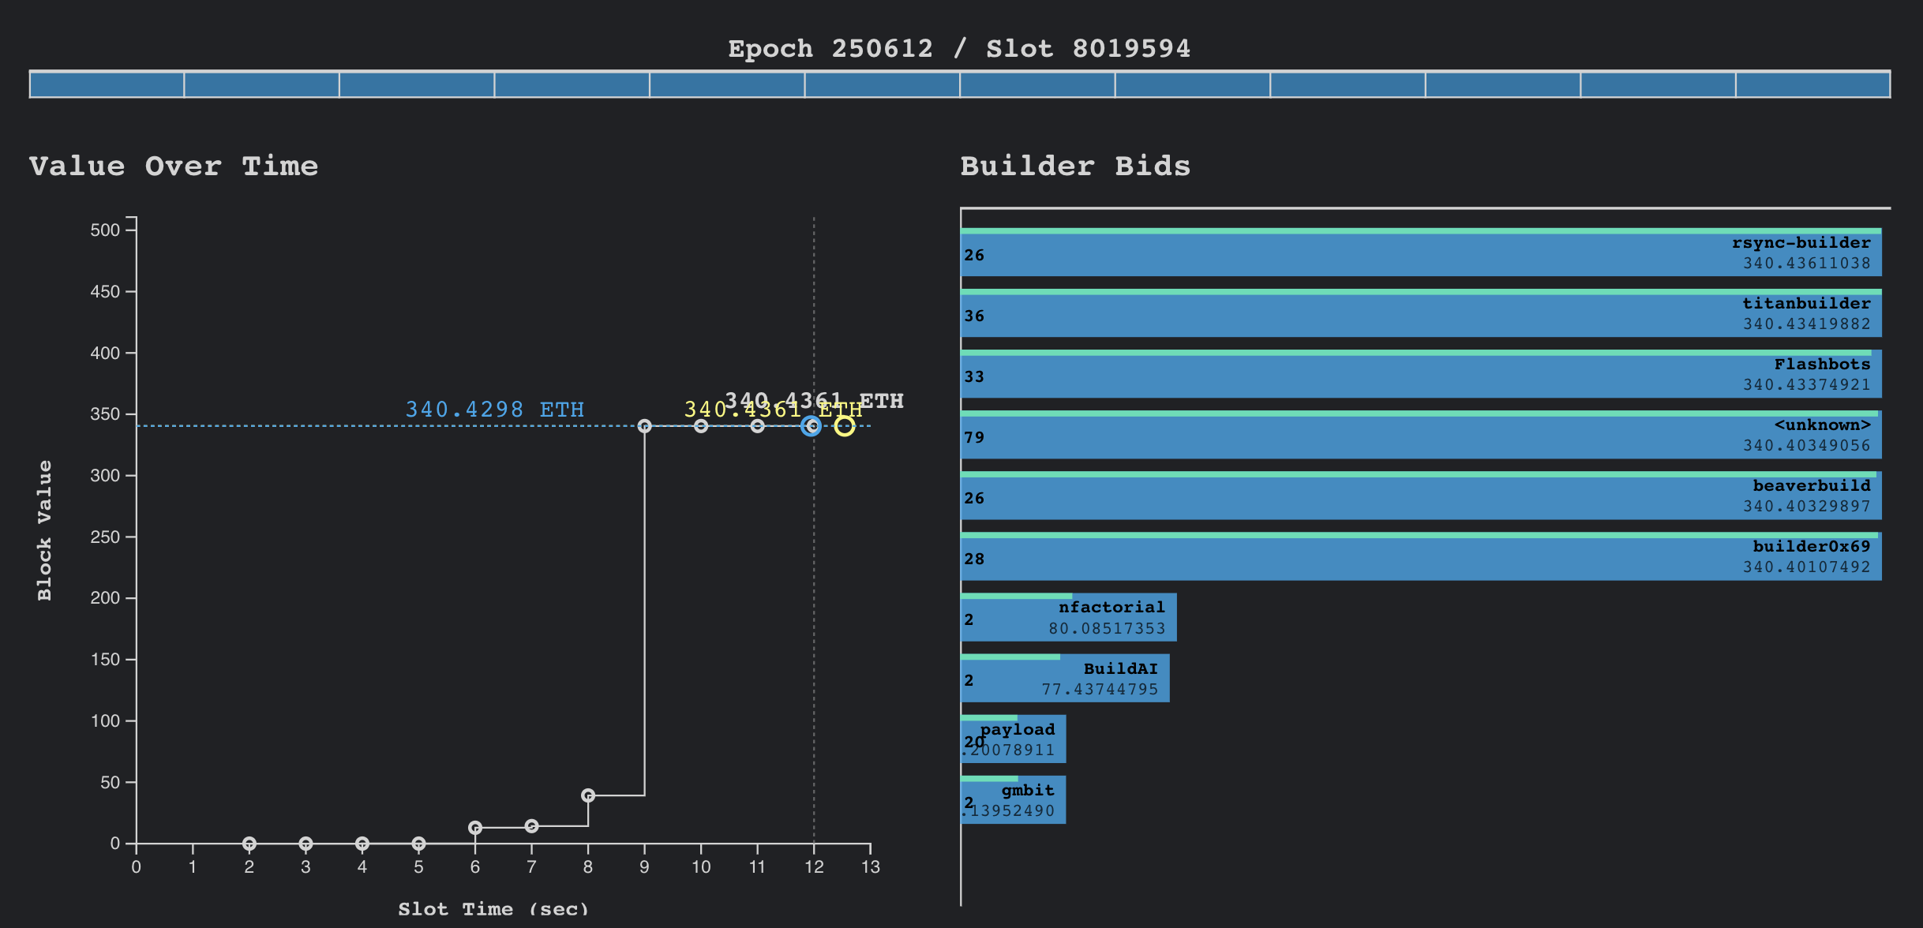
Incentive for integration
For example, in slot 8019594, about 340 ETH came from Banana Gun (OF), and all 340 ETH was captured by the proposer.
Banana Gun: why don’t send to just one builder?
Every top builder bids 340 ETH
Notes:
what’s more troubling is that integration

Slide 20
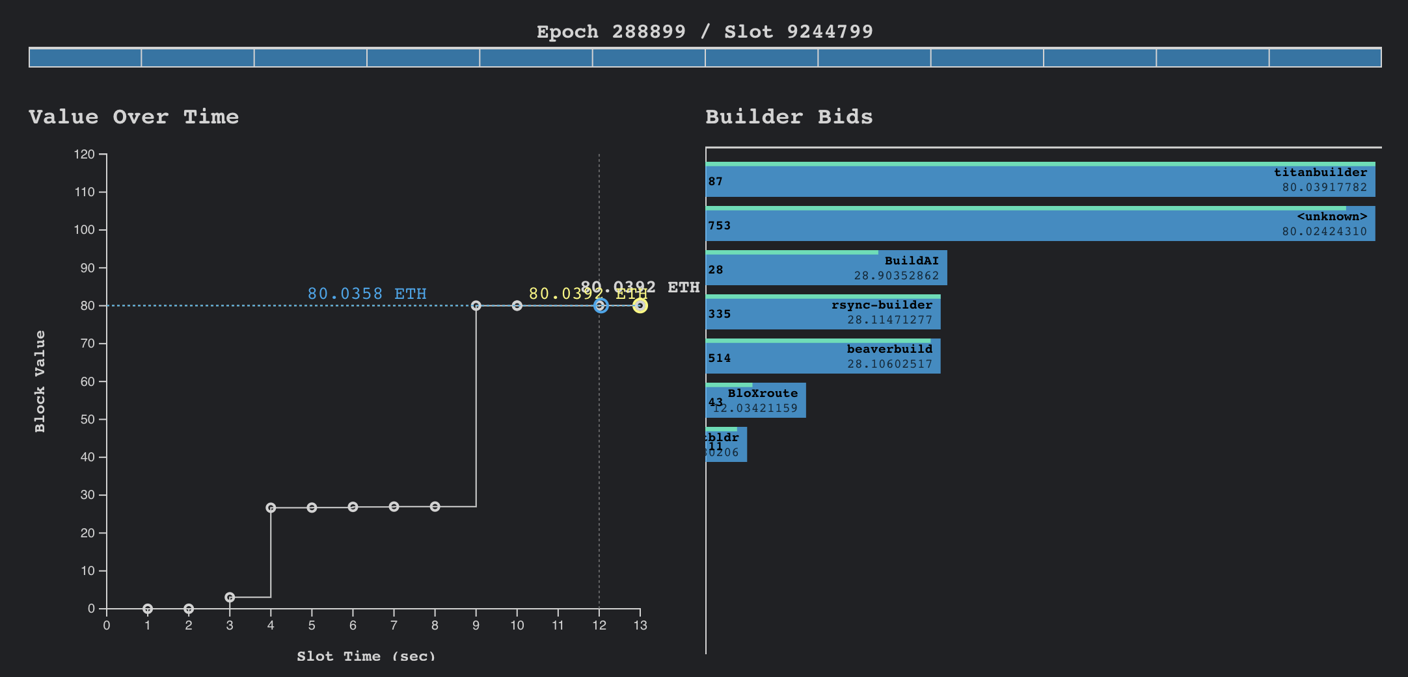
Incentive for integration
With integration, more MEV “escapes” the protocol
E.g., Top 3 builders (all with integrated OFs) made $5.5M in the first of week of June 2024!
In slot 9244799, 208 ETH came from Banana Gun, and only Titan received it. Titan paid 80 ETH to the proposer.
128 ETH can be shared between Banana Gun and Titan!
Titan dominates this auction.

Slide 21
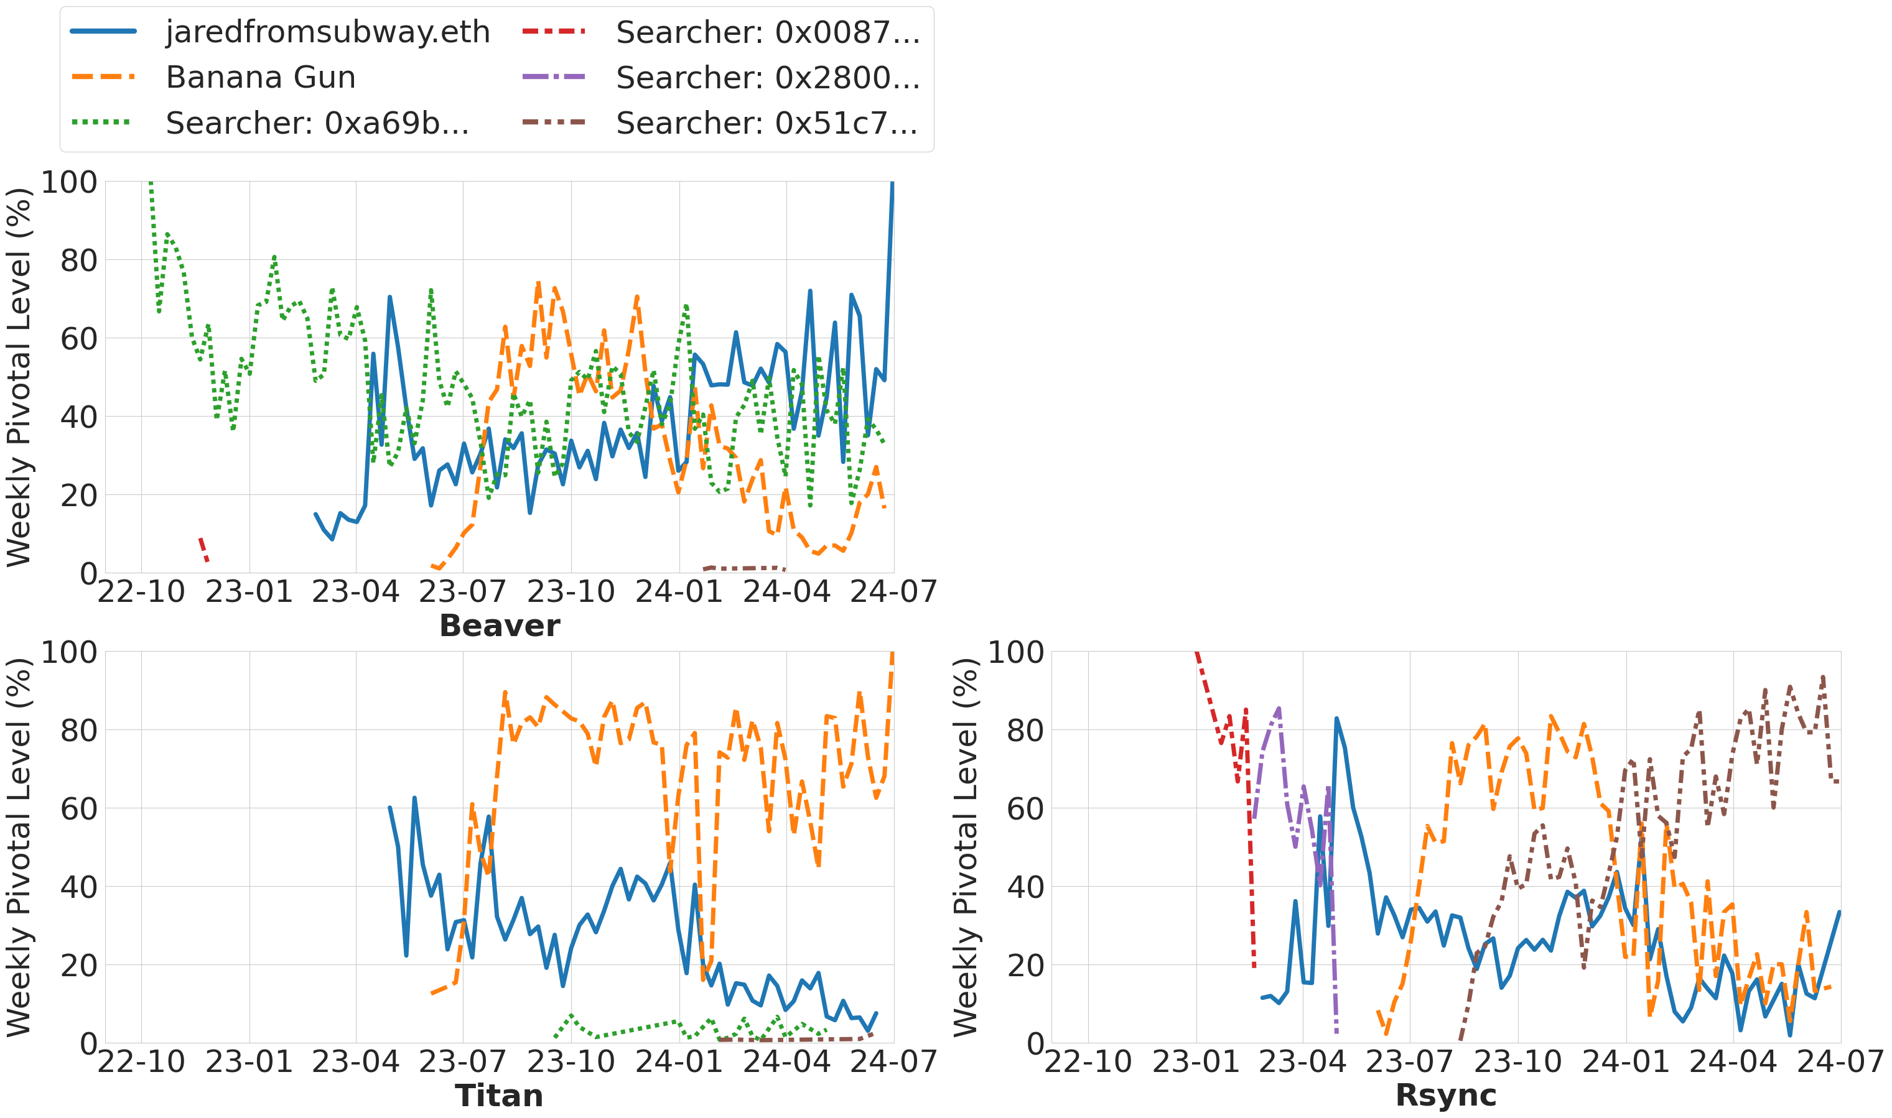
Trend of integration
Pivotal level for top-3 builders (focusing on the blocks those bid value > 1ETH)
The trends of integration between Banana Gun and Titan, jaredfromsubway and Beaver are more obvious.
Notes:
We can observe that since the start of 2024, Banana Gun has become less pivotal to other builders but more pivotal to Titan. jaredfromsubway is less pivotal to others but more pivotal to Beaver. These observations suggest that the trend of integration is becoming more apparent.

Slide 22
Summary: causes & implications of centralized builder markets
Inaccurate MEV oracles 🙁🙁 E.g., less MEV will be burned in MEV burn.
…
Instability of PBS. 🙁🙁 I.e., proposers incentivized to extract MEV by themselves
Trust barrier
Builder Centralization
Proposer loss 🙁
Integration
Important problems but out of scope
Immediate problems like censorship, etc
Validator centralization 🙁🙁🙁
Strong incentive!

Slide 23
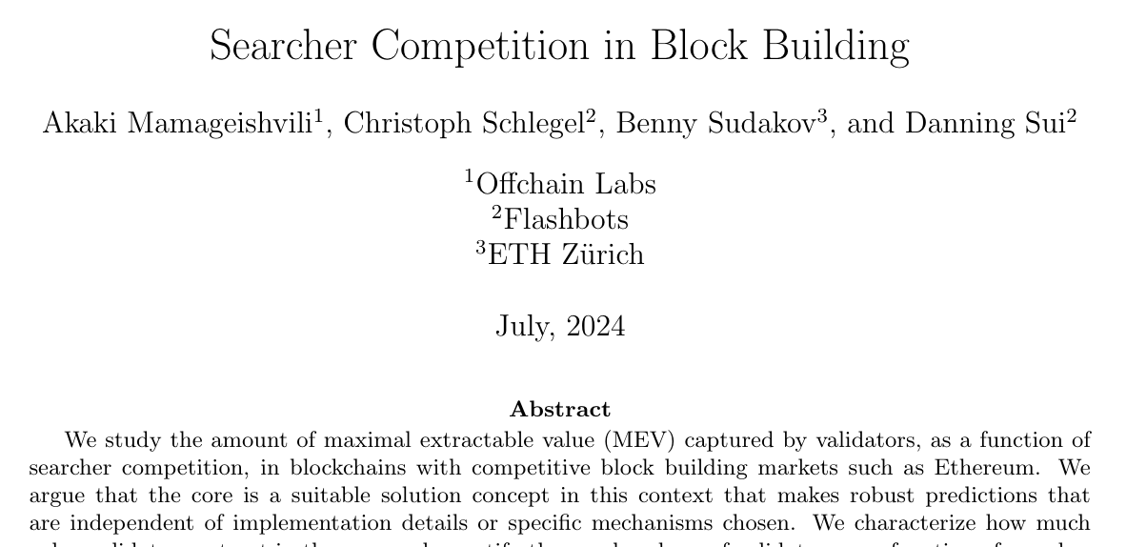
Solutions to pieces of the puzzle
Problem: MEV can’t be accurately measured by current MEV auctions
Potential solution: alternative mechanisms (e.g., Mamageishvili et al. presented a truthful refund mechanism)

Slide 24
Solutions to pieces of the puzzle
Problem: trust barrier between searcher and builders
Potential solution: Put builders in Trusted Execution Environments (TEEs)
Combining the two: run the mechanism from Mamageishvili et al. in TEE?
MEV
Regular users
Wallets
Trading bots
Searchers
TXs
Builder
TEE
Proposers
Mamageishvili et al. is truthful assuming a monopolistic builder!
E.g., Flashbots run a TEE builder

Slide 25
Open challenges
How should MEV be allocated between users, searchers, builders, proposers?
How to mitigate the negative impacts of integration?
Execution Auctions, PROF, etc, do not directly address this problem.
Immediate problems like builder censorship resistance
Blog post: https://decentralizedthoughts.github.io/2024-05-07-decentralization-ethereum/
Paper: https://arxiv.org/pdf/2405.01329
X: 0xfanzhang

Slide 26
What caused inequality?
Public mempool (p2p network)
Regular users
Wallets
Trading bots
Searchers
TXs
Third-party private channels
(MEV-Share, MEV Blocker, etc)
Builders
*) Searchers read from mempool and private channels
Direct channels
Public Order Flow
Private Order Flow
Builder model:
Builders take TXs as input and produce blocks with highest gains
Builder’s gain = balance increase after executing TXs
26
Notes:
before diving into results, let’s first take a closer look at how exactly builders work.
In today’s Ethereum, transactions reach builders via three means
// Here is our model of builders. This model captures the strategic actions taken by builders
// We assume builders do not create transactions (they delegate that to searchers)

Slide 27
Mitigation ideas
It is possible to build an accurate MEV oracle and allocate fair MEV to proposers!
Outsourcing block building to a TEE builder that implements a refund mechanism. For a provider, this mechanism refunds the marginal value of its TXs.
Trust barrier: TEE guarantees integrity and confidentiality.
Integration: Refunds incentivize providers to report their value truthfully. Proof is in (Searcher Competition in Block Building, AFT’24).
The builder can build the optimal block and provide an accurate MEV measurement.
But this might not be the end state.

Slide 28
Mitigation ideas
Refunds incentivize providers to report their value truthfully. Proof is in (Searcher Competition in Block Building, AFT’24).
Accurate MEV measurement: every provider sends TXs to the builder and reports value truthfully.
For every provider, the builder refunds the marginal contribution of its TXs to the block’s TV.
Integration
✅
MEV
Regular users
Wallets
Trading bots
Searchers
MEV
TXs
Builder
TEE
Proposers
For TXs, TEE guarantees integrity and confidentiality
This might not be the end state.
Trust barrier
✅

